Slide 1
Biologists Meet Booth

Slide 2
Registering for Classes
Courtney Burrows, PhD

Slide 3
Class Registration I
All instructions can be found here:
https://www.chicagobooth.edu/programs/taking-courses-at-booth
1. Talk to your PI – this course will be on your transcript – your PI will know about it!
2. Talk to Diane or Booth Registrar to make sure there is no impact on degree requirements (you have to change how many credit you register for lab)
3. Note about tuition…

Slide 4
Class Registration II
Once you are all set and have the OK from your PI and the department:
1. Read up on policies – drops, withdraws, grades etc.
2. Check out class options using the class search tool:
https://intranet.chicagobooth.edu/pub/coursesearch/coursesearch
Pay attention to: “no non-Booth students” and prerequisites
3. You should reach out to the instructor – some courses require consent, but regardless you should talk with them

Slide 5
Class Registration III
Courses are offered on a space-available basis after Booth students have had first priority for registration
You probably won’t get the most popular classes
You can get better classes night, weekends, Friday, Monday or AM classes
In the course search tool look at the instructor evaluations

Slide 6
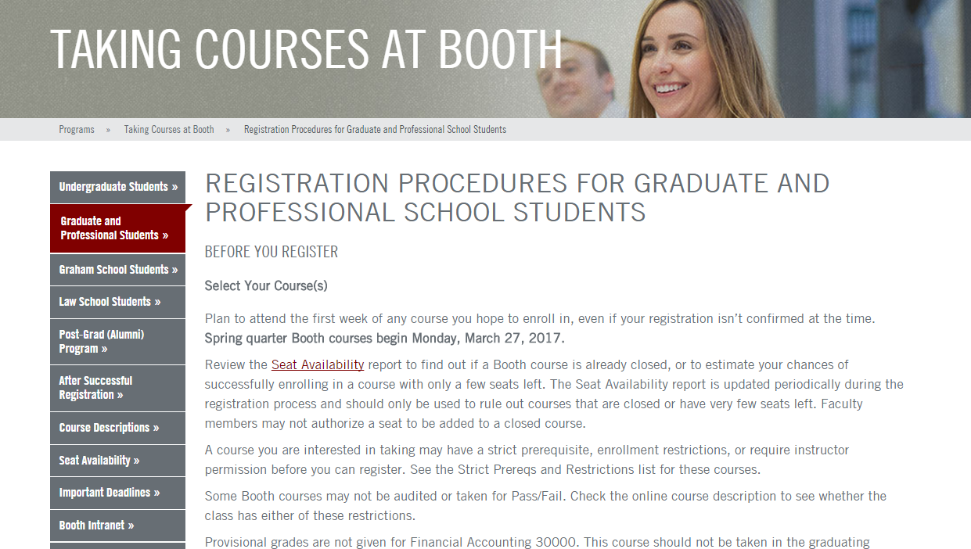

Slide 7
Registration Contacts
Biological Sciences Division
Diane Hall
d-hall@uchicago.edu
Physical Sciences Division
Shirley Proby
sproby@uchicago.edu

Slide 8
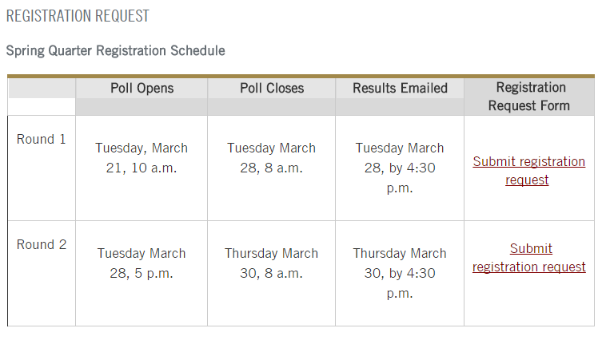

Slide 9
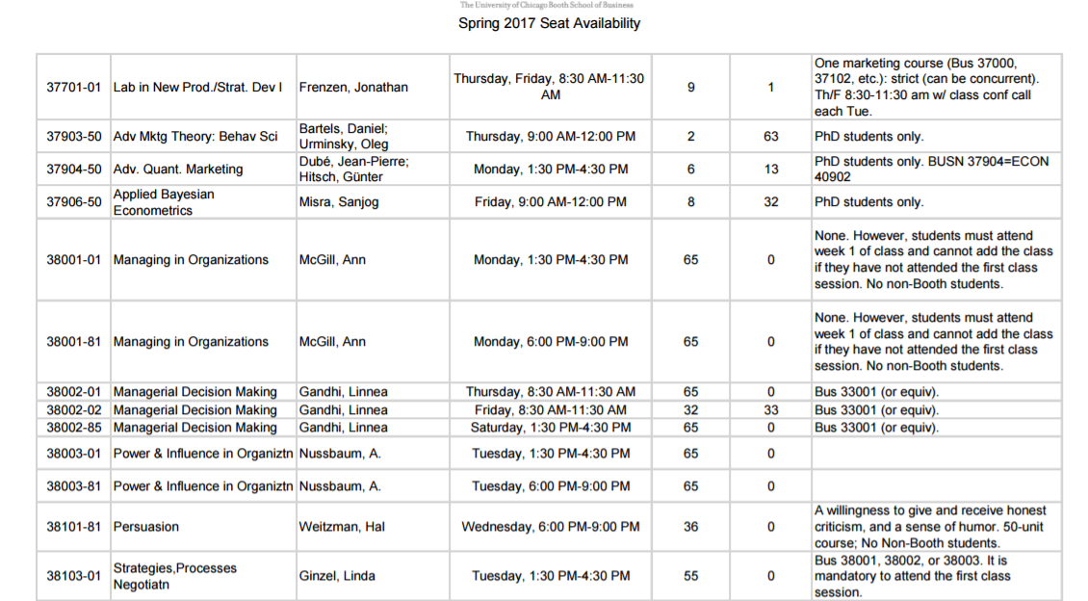

Slide 10
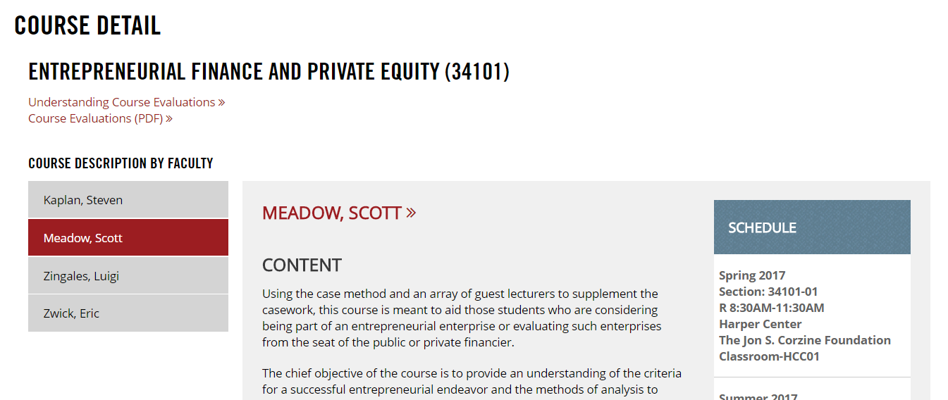

Slide 11
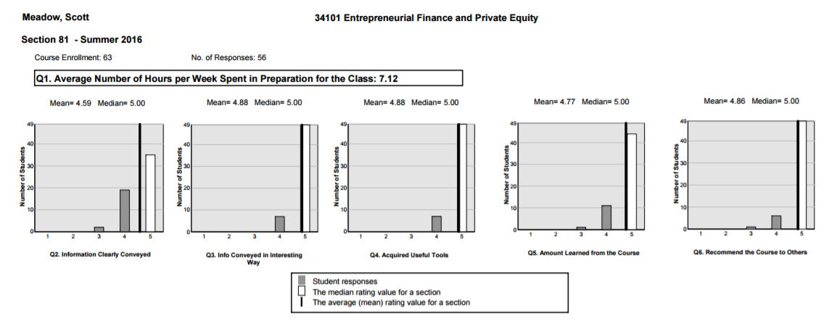

Slide 12
Recommended Classes
Avoid classes with prerequisites and start with the basics!
General Skills:
Managerial Decision Making (talking about biases)
Negotiations
Strategy and Structure
Microeconomics
Management Lab (Frenzen)

Slide 13
Recommended Classes
Consulting-focused:
New Venture Strategy
Managerial Decision Modeling (Ata Baris)
-Excel, ops problem and quantification
Strategy Lab (Davis)
Marketing Strategy
Investment/Entrepreneurship-focused:
Entrepreneurial Finance and Private Equity
Commercializing Innovation
Building the New Venture (Waverly – entrepreneurship)
New Venture Strategy

Slide 14
Contact Information:
Courtney Burrows, PhD
MBA Candidate | Class of 2017
courtneykagan@gmail.com
clk@chicagobooth.edu

